Slide 1
Cache-Oblivious Algorithms
Authors: Matteo Frigo, Charles E. Leiserson, Harald Prokop & Sridhar Ramachandran.
Presented By: Solodkin Yuri.

Slide 2
Papers
Matteo Frigo, Charles E. Leiserson, Harald Prokop, and Sridhar Ramachandran. Cache-oblivious algorithms. In Proceedings of the 40th Annual Symposium on Foundations of Computer Science, pages 285-297, New York, October 1999.
All images and quotes used in this presentation are taken from this article, unless otherwise stated.

Slide 3
Overview
Introduction
Ideal-cache model
Matrix Multiplication
Funnelsort
Distribution Sort
Justification for the ideal-cache model
Discussion

Slide 4
Introduction
Cache Aware: contains parameters (set at either compile-time or runtime) that can be tuned to optimize the cache complexity for the particular cache size and line length.
Cache Oblivious: no variables dependent on hardware parameters, such as cache size and cache-line length, need to be tuned to achieve optimality.
Overview

Slide 5
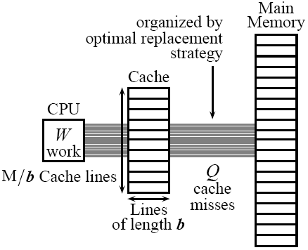
Ideal Cache Model
Optimal replacement
Exactly two levels of memory
Automatic replacement
Full associativity
Tall cache assumption
M = Ω(b²)
Overview

Slide 6
Matrix Multiplication
The goal is to multiply two n x n matrices A and B, to produce their product C, in I/O efficient way.
We assume that n >> b.

Slide 7
Matrix Multiplication
Cache aware: blocked algorithm
  Block-Mult(A, B, C, n)
    For i<- 1 to n/s
      For j<- 1 to n/s
        For k<- 1 to n/s
        do Ord-Mult (A_{ik}, B_{kj}, C_{ij}, s)
  The Ord-Mult (A, B, C, s) subroutine computes C <- C + AB on s x s matrices using an ordinary o(s³) algorithm.

Slide 8
Matrix Multiplication
Here s is a tuning parameter.
s is the largest value so that three s x s sub matrices simultaneously fit in cache.
We will choose s = o(√M).
Then every Ord-Mult cost o(s²/b) IOs.
And for the entire algorithm
o(1 + n²/b + (n/s)³(s²/b)) =
o(1 + n²/b + n³/(b*√M)).
Notes:
o(1 + n²/b + (n/s)³(s²/b)) =
o(1 + n²/b + n³/(b*√M)).

Slide 9
Matrix Multiplication
Now we will introduce a cache oblivious algorithm.
The goal is multiplying an m x n matrix by an n x p matrix cache-obliviously in a I/O efficient way.

Slide 10
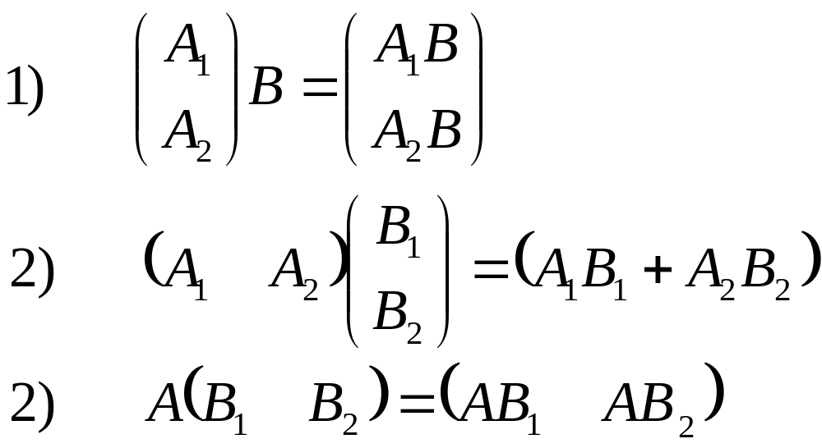
Matrix Multiplication-Rec-Mult
Rec-Mult:
Halve the largest of the three dimensions and recurs according to one of the three cases:
Notes:
The base case occurs when m = n = p = 1

Slide 11
Matrix Multiplication-Rec-Mult
Although this algorithm contains no tuning parameters, it uses cache optimally.
It incurs Q(m+n+p + (mn+np+mp)/b+mnp/L√M) cache misses.
It can be shown by induction that the work of REC-MULT is Θ(mnp).

Slide 12
Matrix Multiplication
Intuitively, REC-MULT uses the cache effectively, because once a sub problem fits into the cache, its smaller sub problems can be solved in cache with no further cache misses.
Overview

Slide 13
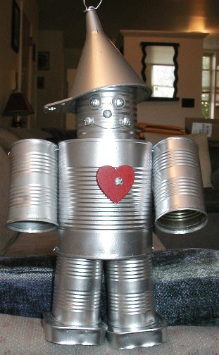
Funnelsort
Here we will describes a cache-oblivious sorting algorithm called funnelsort.
This algorithm has optimal O(nlgn) work complexity, and optimal O(1+(n/b)(1+log_{M}n)) cache complexity.

Slide 14
Funnelsort
In a way it is similar to Merge Sort.
We will split the input into n^{1/3} contiguous arrays of size n^{2/3}, and sort these arrays recursively.
Then merge the n^{1/3} sorted sequences using a n^{1/3}-merger.

Slide 15
Funnelsort
Merging is performed by a device called a k-merger.
k-merger suspends work on a merging sub problem when the merged output sequence becomes “long enough”.
Then the algorithm resumes work on another sub problem.

Slide 16
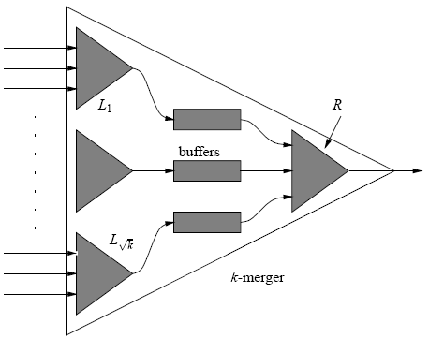
Funnelsort
The k inputs are partitioned into √k sets of √k elements.
The outputs of these mergers are connected to the inputs of √k buffers.
  √k buffer: A FIFO queue that can hold up to 2k^{3/2} elements.
Finally, the outputs of the buffers are connected to the √k -merger R.

Slide 17
Funnelsort
Invariant: Each invocation of a k-merger outputs the next k³ elements of the sorted sequence obtained by merging the k input sequences.

Slide 18
Funnelsort
In order to output k³ elements, the k-merger invokes R k^{3/2} times.
Before each invocation, however, the k-merger fills all buffers that are less than half full.
In order to fill buffer i, the algorithm invokes the corresponding left merger L_{i} once.
Notes:
(k^{3/2} · k^{3/2} = k³).
2) (contain less than k^{3/2} elements).
3) Since L_{i} outputs k^{3/2} elements, the buffer contains at least k^{3/2} elements after L_{i} finishes.

Slide 19
Funnelsort
The base case of the recursion is a k-merger with k = 2, which produces k³ = 8 elements whenever invoked.
It can be proven by induction that the work complexity of funnelsort is O(nlgn).

Slide 20
Funnelsort
We will analyze the I/O complexity and prove that that funnelsort on n elements requires at most O(1+(n/b)(1+log_{M}n)) cache misses.
In order to prove this result, we need three auxiliary lemmas.

Slide 21
Funnelsort
The first lemma bounds the space required by a k-merger.
Lemma 1: k-merger can be laid out in O(k²) contiguous memory locations.

Slide 22
Funnelsort
Proof:
  A k-merger requires O(k²) memory locations for the buffers.
  It also requires space for his √k-mergers, a total of √k + 1 mergers.
  The space S(k) thus satisfies the recurrence S(k) = (√k+1)·S(√k) + O(k²).
  Whose solution is S(k) = O(k²).
Notes:
L₁,…,L_{√k} and R

Slide 23
Funnelsort
The next lemma guarantees that we can manage the queue cache-efficiently.
Lemma 2: Performing r insert and remove operations on a circular queue causes in O(1+r/b) cache misses as long as two cache lines are available for the buffer.

Slide 24
Funnelsort
Proof:
  Associate the two cache lines with the head and tail of the circular queue.
  If a new cache line is read during a insert (delete) operation, the next b - 1 insert (delete) operations do not cause a cache miss.

Slide 25
Funnelsort
The next lemma bounds the cache complexity of a k-merger.
Lemma 3: If M = Ω(b²), then a k-merger operates with at most
Q_{m}(k) = O(1 + k + k³/b + k³ log_{m}k/b) cache misses.

Slide 26
Funnelsort
In order to prove this lemma we will introduce a constant α, for which if
k < α√M the k-merger fits into cache.
Then we will distinguish between two cases: k is smaller or larger then α√M.
Notes:
Such α exists because we have shown that a k-merger fits in O(k²) space.

Slide 27
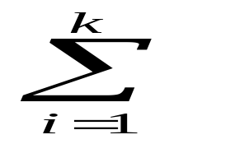
Funnelsort
Case I: k < α√M
  Let r_{i} be the number of elements extracted from the ith input queue.
  Since k < α√M and b = O(√M), there are Ω(k) cache lines available for the input buffers.
  Lemma 2 applies: whence the total number of cache misses for accessing the input queues is
  O(1+r_{i}/b) = O(k+k³/b).
Notes:
The data structure associated with the k-merger fits into the cache.
The k-merger has k input queues from which it loads O(k³) elements
Last) whence the total number of cache misses for accessing the input queues is

Slide 28
Funnelsort
Continuance:
  Similarly, Lemma 2 implies that the cache complexity of writing the output queue is O(1+k³/b).
  Finally, the algorithm incurs O(1+k²/b) cache misses for touching its internal data structures.
  The total cache complexity is therefore Q_{m}(k) = O(1 + k + k³/b).

Slide 29
Funnelsort
Case II: k > α√M
We will prove by induction on k that Q_{m}(k) = ck³ log_{M}k/b - A(k)
where
A(k) = k(1 + 2clog_{M}k/b) = o(k³).
The base case: αM^{1/4} < k < α √M is a result of case I.

Slide 30
Funnelsort
For the inductive case, we suppose that k > α√M.
The k-merger invokes the √k-mergers recursively.
Since αM^{1/4} < √k <k, the inductive hypothesis can be used to bound the number Q_{m}(√k) of cache misses incurred by the submergers.

Slide 31
Funnelsort
The merger R is invoked exactly k^{3/2} times.
The total number l of invocations of “left” mergers is bounded by l < k^{3/2}+2√k.
  Because every invocation of a “left” merger puts k^{3/2} elements into some buffer.

Slide 32
Funnelsort
Before invoking R, the algorithm must check every buffer to see whether it is empty.
One such check requires at most √k cache misses.
This check is repeated exactly k^{3/2} times, leading to at most k² cache misses for all checks.
Notes:
2) Since there are √k buffers.

Slide 33
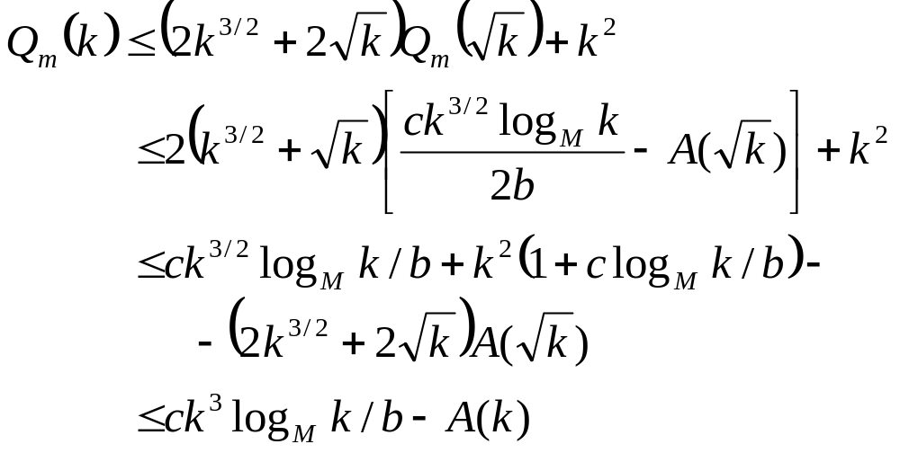
Funnelsort
These considerations lead to the recurrence

Slide 34
Funnelsort
Now we return to prove our algorithms I/O bound.
To sort n elements, funnelsort incurs O(1+(n/b)(1+log_{M}n)) cache misses.
Again we will examine two cases.

Slide 35
Funnelsort
Case I: n < αM for a small enough constant α.
Only one k-merger is active at any time.
The biggest k-merger is the top-level n^{1/3}-merger, which requires O(n^{2/3}) < O(n) space.
And so the algorithm fits into cache.
The algorithm thus can operate in O(1+n/b) cache misses.

Slide 36
Funnelsort
Case II: If n > αM, we have the recurrence Q(n) = n^{1/3}Q(n^{2/3})+Q_{m}(n^{1/3}) .
By Lemma 3, we have Q_{M}(n^{1/3}) = O(1 + n^{1/3} + n/b + nlog_{M}n/b)
We can simplify to Q_{m}(n^{1/3}) = O(nlog_{M}n/b).
The recurrence simplifies to Q(n) = n^{1/3}Q(n^{2/3})+ O(nlog_{M}n/b).
The result follows by induction on n.
Overview

Slide 37
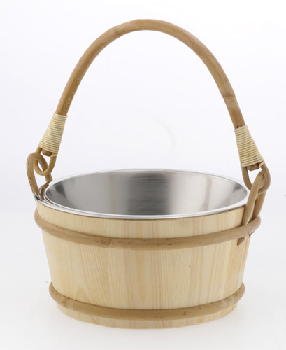
Distribution Sort
Like the funnelsort the distribution sorting algorithm uses O(nlgn) work and it incurs O(1+(n/b)(1+log_{M} n)) cache misses.
The algorithm uses a “bucket splitting” technique to select pivots incrementally during the distribution step.

Slide 38
Distribution Sort
Given an array A of length n, we do the following:
  Partition A into √n contiguous subarrays of size √n.
  Recursively sort each subarray.

Slide 39

Distribution Sort
  2. Distribute the sorted subarrays into q buckets B₁,…,B_{q} of size n₁,…,n_{q} such that
    Max{x | x B_{i}} ≤ min{x | x B_{i+1}}
    n_{i} ≤ 2√n
  3. Recursively sort each bucket.
  4. Copy the sorted buckets to array A.

Slide 40
Distribution Sort
Two invariants are maintained.
First, at any time each bucket holds at most 2√n elements, and any element in bucket B_{i} is smaller than any element in bucket B_{i+1}.
Second, every bucket has an associated pivot. Initially, only one empty bucket exists with pivot ∞.

Slide 41
Distribution Sort
For each sub array we keep the index next of the next element to be read from the sub array and the bucket number bnum where this element should be copied.
For every bucket we maintain the pivot and the number of elements currently in the bucket.

Slide 42
Distribution Sort
We would like to copy the element at position next of a subarray to bucket bnum.
If this element is greater than the pivot of bucket bnum, we would increment and try again.
This strategy has poor caching behavior.

Slide 43
Distribution Sort
This calls for a more complicated procedure.
The distribution step is accomplished by the recursive procedure DISTRIBUTE (i, j, m).
Which distributes elements from the ith through (i+m-1)th sub arrays into buckets starting from B_{j}.

Slide 44
Distribution Sort
The execution of DISTRIBUTE(i, j, m) enforces the post condition that sub arrays i,i+1,…, i+m-1 have their bnum j+m.
Step 2 of the distribution sort invokes DISTRIBUTE(1, 1, √n).

Slide 45
Distribution Sort
DISTRIBUTE (i, j, m)
  if m = 1 COPYELEMS(i, j)
  else
    DISTRIBUTE (i, j, m/2)
    DISTRIBUTE (i+m/2, j, m/2)
    DISTRIBUTE (i, j+m/2, m/2)
    DISTRIBUTE (i+m/2, j+m/2, m/2)

Slide 46
Distribution Sort
The procedure COPYELEMS(i, j) copies all elements from sub array i, that belong to bucket j.
If bucket j has more than 2√n elements after the insertion, it can be split into two buckets of size at least √n.

Slide 47
Distribution Sort
For the splitting operation, we use the deterministic median-finding algorithm followed by a partition.
The median of n elements can be found cache-obliviously incurring O(1+n/L) cache misses.
Overview

Slide 48
Ideal Cache Model Assumptions
Optimal replacement
Exactly two levels of memory

Slide 49
Optimal Replacement
Optimal replacement replacing the cache line whose next access is furthest in the future.
LRU discards the least recently used items first.

Slide 50
Optimal Replacement
Algorithms whose complexity bounds satisfy a simple regularity condition can be ported to caches incorporating an LRU replacement policy.
Regularity condition:
Q(n, M, b) = O(Q(n , 2M, b))

Slide 51
Optimal Replacement
Lemma: Consider an algorithm that causes Q*(n, M, b) cache misses using a (M, L) ideal cache. Then, the same algorithm incurs Q (n, M, b) ≤ 2Q*(n, M/2, b) cache misses on a cache that uses LRU replacement.

Slide 52
Optimal Replacement
Proof: Sleator and Tarjan¹ have shown that the cache misses using LRU replacement are (M/b)=((M-M*)/b + 1)-competitive with optimal replacement on a (M*, L) ideal cache if both caches start empty.
It follows that the number of misses on a (M, L) LRU-cache is at most twice the number of misses on a (M/2, b) ideal-cache.
1. D. D. Sleator and R. E. Tarjan. Amortized efficiency of list update and paging rules. Communications of the ACM, 28(2):202–208, Feb. 1985.

Slide 53
Optimal Replacement
If the algorithm satisfy:
  Q(n, M, b) = O(Q(n , 2M, b)).
  Complexity bound Q(n, M, b)
Then the number of cache misses with LRU replacement is
Θ(Q(n, M, b)).

Slide 54
Exactly Two Levels Of Memory
Models incorporating multiple levels of caches may be necessary to analyze some algorithms.
For cache-oblivious algorithms Analysis in the two-level ideal-cache model suffices.

Slide 55
Exactly Two Levels Of Memory
Justification:
  Every level i of a multilevel LRU model always contains the same cache lines as a simple cache.
  This can be achieved with coloring rows that appears in the higher cache levels.
Notes:
that serves the same sequence of memory accesses.

Slide 56
Exactly Two Levels Of Memory
Therefore an optimal cache-oblivious algorithm incurs an optimal number of cache misses on each level of a multilevel cache with LRU replacement.
Overview

Slide 57
Discussion
What is the range of cache-oblivious algorithms?
What is the relative strength between cache-oblivious algorithms and cache aware algorithms?
Overview

Slide 58
The End.
Thanks to Bobby Blumofe who sparked early discussions about what we now call cache obliviousness.

